Slide 1

Chapter 3
Using Classes and Objects
(Modified)

Slide 2
Chapter Scope
Creating objects
Services of the String class
The Java API class library
The Random and Math classes
Formatting output
Introducing enumerated types
Wrapper classes

Slide 3
The Java API
A class library is a collection of classes that we can use when developing programs
The Java API is the standard class library that is part of any Java development environment
API stands for Application Programming Interface
Various classes we've already used (System , Scanner, String) are part of the Java API
Other class libraries can be obtained through third party vendors, or you can create them yourself

Slide 4
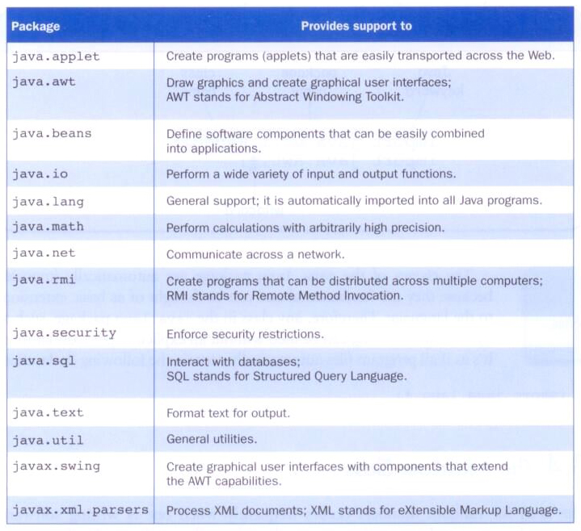
Packages
The classes of the Java API are organized into packages

Slide 5
Import Declarations
When you want to use a class from a package, you could use its fully qualified name
java.util.Scanner
Or you can import the class, and then use just the class name:
import java.util.Scanner;
To import all classes in a particular package, you can use the * wildcard character:
import java.util.*;

Slide 6
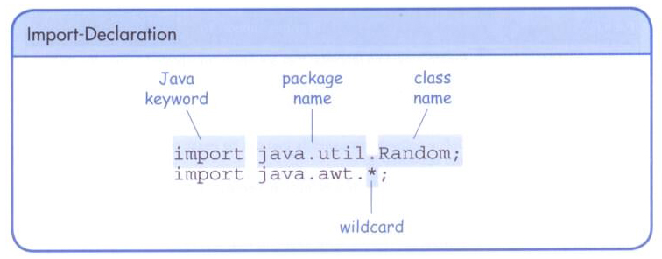
Import Declarations

Slide 7
The java.lang Package
All classes of the java.lang package are imported automatically into all programs
It's as if all programs contain the following line
import java.lang.*;
That's why we didn't have to import the System or String classes explicitly in earlier programs
The Scanner class, on the other hand, is part of the java.util package, and therefore must be imported

Slide 8
The String Class
Once a String object has been created, neither its value nor its length can be changed
Thus we say that an object of the String class is immutable
However, several methods of the String class return new String objects that are modified versions of the original

Slide 9
Creating Objects
A variable holds either a primitive type or a reference to an object
A class name can be used as a type to declare an object reference variable
String title;
No object is created with this declaration
An object reference variable holds the address of an object

Slide 10
Memory Diagram
title
No String object is created yet. Therefore, Object reference variable title does not refer to any.
//At the time what happen if we execute the //following?
System.out.println(“ The title is “ + title);
String title;
null

Slide 11
Creating Objects
Generally, we use the new operator to create an object:
title = new String("James Gosling");
Creating an object is called instantiation
An object is an instance of a particular class
title now refer to an object “James Gosling”
This calls the String constructor, which is
a special method that sets up the object

Slide 12
Memory Diagram
title
title = new String("James Gosling");
James Gosling
Objects are created in the memory called heap

Slide 13
Creating Strings
Because strings are so common, we don't have to use the new operator to create a String object
title = "Java rocks!";
This is special syntax that works only for strings
Each string literal (enclosed in double quotes) represents a String object

Slide 14
Object References cont.
A primitive variable contains the value itself
An object variable contains the address of the object
An object reference can be thought of as a pointer to the location of the object
Rather than dealing with arbitrary addresses, we often depict a reference graphically
num1
38
name1
"Steve Jobs"

Slide 15
Assignment Revisited
The act of assignment takes a copy of a value and stores it in a variable
For primitive types:
num1
38
Before:
num2
96
num2 = num1;
num1
38
After:
num2
38

Slide 16
Assignment Revisited
For object references, the address is copied:
name1
"Steve Jobs"
Before:
name2
"Steve Wozniak"
name2 = name1;
name1
"Steve Jobs"
After:
name2

Slide 17
Aliases
Two or more references that refer to the same object are called aliases of each other
That creates an interesting situation: one object can be accessed using multiple reference variables
Aliases can be useful, but should be managed carefully
Changing an object through one reference changes it for all of its aliases, because there is really only one object

Slide 18
Garbage Collection
When an object no longer has any valid references to it, it can no longer be accessed by the program
The object is useless, and therefore is called garbage
Java performs automatic garbage collection periodically, returning an object's memory to the system for future use
In other languages, the programmer is responsible for performing garbage collection explicitly

Slide 19
Invoking Methods
We've seen that once an object has been instantiated, we can use the dot operator to invoke its methods
count = title.length()
A method may return a value, which can be used in an assignment or expression
A method invocation can be thought of as asking an object to perform a service or action

Slide 20
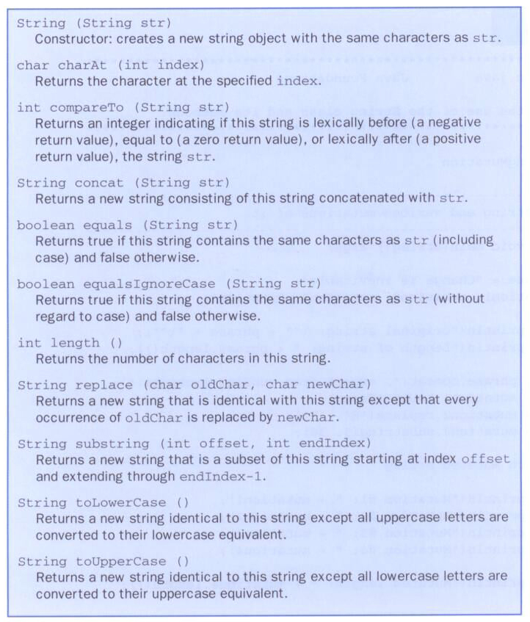
Some methods of the String class:

Slide 21
General Method Header Structure
return datatype method name (data-type parameter-variables…)
Some String Class’s methods from the previous List (API):
String replace (char oldChar , char newChar)
int length ( )
char charAt ( int index )
© 2006 Pearson Education.
All Rights Reserved

Slide 22
General Method Header Structure
return datatype method name (data-type parameter-variables…)
String replace (char oldChar , char newChar)
Using it in our program:
String str1 = "Ha ha ha";
String str2 = str1.replace('a' , 'e’);
System.out.println(" The new string: "+ str2);
//Output: The new string is: He he he
© 2006 Pearson Education.
All Rights Reserved

Slide 23
The String Class
It is occasionally helpful to refer to a particular character within a string
This can be done by specifying the character's numeric index
The indexes begin at zero in each string
In the string "Hello", the character 'H' is at index 0 and the 'o' is at index 4

Slide 24
General Method Header Structure
return datatype method name (data-type parameter-variables…)
char charAt ( int index )
Using it in our program:
String str1 = "Java is fun " ;
char ch;
ch = str1.charAt(0); //method call
System.out.println("Character at index 0:" + ch);
//Output: Character at index 0: J
© 2006 Pearson Education.
All Rights Reserved

Slide 25
//********************************************************************
// StringMutation.java Java Foundations
//
// Demonstrates the use of the String class and its methods.
//********************************************************************
public class StringMutation
{
//-----------------------------------------------------------------
// Prints a string and various mutations of it.
//-----------------------------------------------------------------
public static void main(String[] args)
{
String phrase = "Change is inevitable";
String mutation1, mutation2, mutation3, mutation4;
System.out.println("Original string: \"" + phrase + "\"");
System.out.println("Length of string: " + phrase.length());
mutation1 = phrase.concat(", except from vending machines.");
mutation2 = mutation1.toUpperCase();
mutation3 = mutation2.replace('E', 'X');
mutation4 = mutation3.substring(3, 30);

Slide 26
// Print each mutated string
System.out.println("Mutation #1: " + mutation1);
System.out.println("Mutation #2: " + mutation2);
System.out.println("Mutation #3: " + mutation3);
System.out.println("Mutation #4: " + mutation4);
System.out.println("Mutated length: " + mutation4.length());
}
}

Slide 27
The Random Class
The Random class is part of the java.util package
It provides methods that generate pseudorandom numbers
A Random object performs complicated calculations based on a seed value to produce a stream of seemingly random values

Slide 28
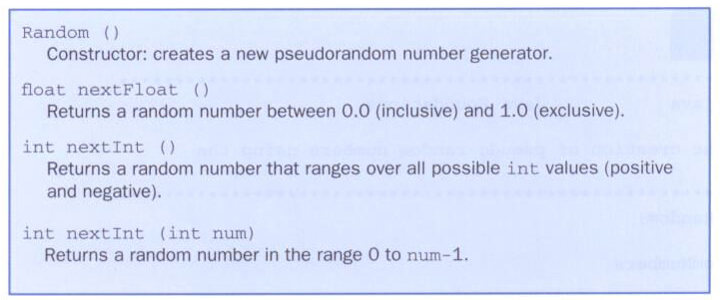
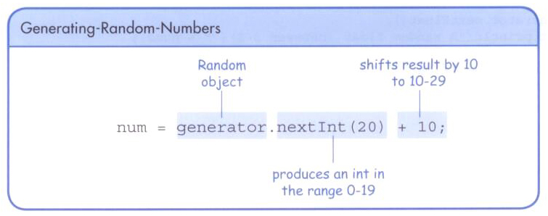
The Random Class
Some methods of the Random class:

Slide 29
//********************************************************************
// RandomNumbers.java Java Foundations
//
// Demonstrates the creation of pseudo-random numbers using the
// Random class.
//********************************************************************
import java.util.Random;
public class RandomNumbers
{
//-----------------------------------------------------------------
// Generates random numbers in various ranges.
//-----------------------------------------------------------------
public static void main(String[] args)
{
Random generator = new Random();
int num1;
float num2;
num1 = generator.nextInt();
System.out.println("A random integer: " + num1);
num1 = generator.nextInt(10);
System.out.println("From 0 to 9: " + num1);

Slide 30
num1 = generator.nextInt(10) + 1;
System.out.println("From 1 to 10: " + num1);
num1 = generator.nextInt(15) + 20;
System.out.println("From 20 to 34: " + num1);
num1 = generator.nextInt(20) - 10;
System.out.println("From -10 to 9: " + num1);
num2 = generator.nextFloat();
System.out.println("A random float (between 0-1): " + num2);
num2 = generator.nextFloat() * 6; // 0.0 to 5.999999
num1 = (int)num2 + 1;
System.out.println("From 1 to 6: " + num1);
}
}

Slide 31
The Math Class
The Math class is part of the java.lang package, so no need to import it.
The Math class contains methods that perform various mathematical functions
These include:
absolute value
square root
exponentiation
trigonometric functions

Slide 32
The Math Class
The methods of the Math class are static methods (also called class methods)
Static methods can be invoked through the class name – no object of the Math class is needed
value = Math.cos(90) + Math.sqrt(delta);
We'll discuss static methods in more detail later

Slide 33
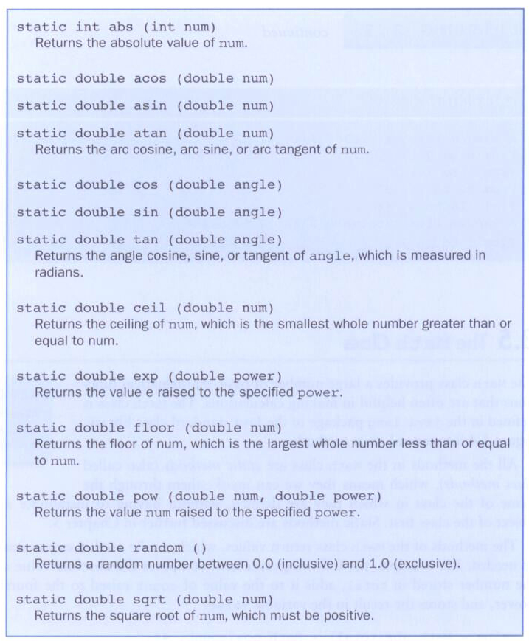
Some methods of the Math class:

Slide 34
General Method Header Structure
return datatype method name (data-type parameter-variables…)
static double pow ( double num, double power)
Using in our program:
double number = 2.0 ;
double cube ;
//No need to create an object when using Math class’ methods
cube = Math.pow(number, 3); //method call
System.out.println("The cube of 2 is:" + cube);
//Output: The cube of 2 is: 8.0
© 2006 Pearson Education.
All Rights Reserved

Slide 35
//********************************************************************
// Quadratic.java Java Foundations
//
// Demonstrates the use of the Math class to perform a calculation
// based on user input.
//********************************************************************
import java.util.Scanner;
public class Quadratic
{
//-----------------------------------------------------------------
// Determines the roots of a quadratic equation.
//-----------------------------------------------------------------
public static void main(String[] args)
{
int a, b, c; // ax^2 + bx + c
double discriminant, root1, root2;
Scanner scan = new Scanner(System.in);
System.out.print("Enter the coefficient of x squared: ");
a = scan.nextInt();
System.out.print("Enter the coefficient of x: ");
b = scan.nextInt();

Slide 36
System.out.print("Enter the constant: ");
c = scan.nextInt();
// Use the quadratic formula to compute the roots.
// Assumes a positive discriminant.
discriminant = Math.pow(b, 2) - (4 * a * c);
root1 = ((-1 * b) + Math.sqrt(discriminant)) / (2 * a);
root2 = ((-1 * b) - Math.sqrt(discriminant)) / (2 * a);
System.out.println("Root #1: " + root1);
System.out.println("Root #2: " + root2);
}
}

Slide 37
Formatting Output
It is often necessary to format values in certain ways so that they can be presented properly
The Java API contains classes that provide formatting capabilities
The NumberFormat class allows you to format values as currency or percentages
The DecimalFormat class allows you to format values based on a pattern
Both are part of the java.text package

Slide 38
Formatting Output
The NumberFormat class has static methods that return a formatter object
getCurrencyInstance()
getPercentInstance()
Each formatter object has a method called format that returns a string with the specified information in the appropriate format

Slide 39
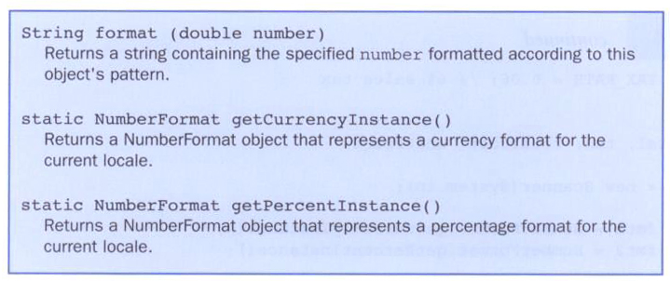
Formatting Output
Some methods of the NumberFormat class:

Slide 40
//********************************************************************
// Purchase.java Java Foundations
//
// Demonstrates the use of the NumberFormat class to format output.
//********************************************************************
import java.util.Scanner;
import java.text.NumberFormat;
public class Purchase
{
//-----------------------------------------------------------------
// Calculates the final price of a purchased item using values
// entered by the user.
//-----------------------------------------------------------------
public static void main(String[] args)
{
final double TAX_RATE = 0.06; // 6% sales tax
int quantity;
double subtotal, tax, totalCost, unitPrice;
Scanner scan = new Scanner(System.in);
NumberFormat fmt1 = NumberFormat.getCurrencyInstance();
NumberFormat fmt2 = NumberFormat.getPercentInstance();

Slide 41
System.out.print("Enter the quantity: ");
quantity = scan.nextInt();
System.out.print("Enter the unit price: ");
unitPrice = scan.nextDouble();
subtotal = quantity * unitPrice;
tax = subtotal * TAX_RATE;
totalCost = subtotal + tax;
// Print output with appropriate formatting
System.out.println("Subtotal: " + fmt1.format(subtotal));
System.out.println("Tax: " + fmt1.format(tax) + " at "
+ fmt2.format(TAX_RATE));
System.out.println("Total: " + fmt1.format(totalCost));
}
}

Slide 42
Formatting Output
The DecimalFormat class can be used to format a floating point value in various ways
For example, you can specify that the number should be truncated to three decimal places
The constructor of the DecimalFormat class takes a string that represents a pattern for the formatted number

Slide 43
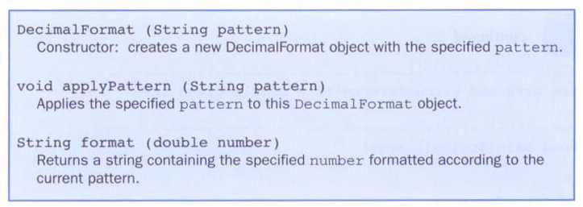
Formatting Output
Some methods of the DecimalFormat class:

Slide 44
General Method Header Structure
return datatype method name (data-type parameter-variables…)
String format (double number )
Using it in our program:
double number = 2.56783 ;
//Create an object with a specific formatting first
DecimalFormat fmt = new DecimalFormat("0.###");
System.out.println("Number rounded to at most 3 decimal places: " + fmt.format(number));
//Output: Number rounded to at most 3 decimal //places: 5.568
© 2006 Pearson Education.
All Rights Reserved

Slide 45
//********************************************************************
// CircleStats.java Java Foundations
//
// Demonstrates the formatting of decimal values using the
// DecimalFormat class.
//********************************************************************
import java.util.Scanner;
import java.text.DecimalFormat;
public class CircleStats
{
//-----------------------------------------------------------------
// Calculates the area and circumference of a circle given its
// radius.
//-----------------------------------------------------------------
public static void main(String[] args)
{
int radius;
double area, circumference;
Scanner scan = new Scanner(System.in);
System.out.print("Enter the circle's radius: ");
radius = scan.nextInt();

Slide 46
area = Math.PI * Math.pow(radius, 2);
circumference = 2 * Math.PI * radius;
// Round the output to three decimal places
DecimalFormat fmt = new DecimalFormat("0.###");
System.out.println("The circle's area: " + fmt.format(area));
System.out.println("The circle's circumference: "
+ fmt.format(circumference));
}
}

Slide 47
Enumerated Types
Java allows you to define an enumerated type, which can then be used to declare variables
An enumerated type establishes all possible values for a variable of that type
The values are identifiers of your own choosing
The following declaration creates an enumerated type called Season
enum Season {winter, spring, summer, fall};
Any number of values can be listed

Slide 48
Enumerated Types
Once a type is defined, a variable of that type can be declared
Season time;
and it can be assigned a value
time = Season.fall;
The values are specified through the name of the type
Enumerated types are type-safe – you cannot assign any value other than those listed

Slide 49
Enumerated Types
Internally, each value of an enumerated type is stored as an integer, called its ordinal value
The first value in an enumerated type has an ordinal value of zero, the second one, and so on
However, you cannot assign a numeric value to an enumerated type, even if it corresponds to a valid ordinal value

Slide 50
Enumerated Types
The declaration of an enumerated type is a special type of class, and each variable of that type is an object
The ordinal method returns the ordinal value of the object
The name method returns the name of the identifier corresponding to the object's value

Slide 51
//********************************************************************
// IceCream.java Java Foundations
//
// Demonstrates the use of enumerated types.
//********************************************************************
public class IceCream
{
enum Flavor {vanilla, chocolate, strawberry, fudgeRipple, coffee,
rockyRoad, mintChocolateChip, cookieDough}
//-----------------------------------------------------------------
// Creates and uses variables of the Flavor type.
//-----------------------------------------------------------------
public static void main(String[] args)
{
Flavor cone1, cone2, cone3;
cone1 = Flavor.rockyRoad;
cone2 = Flavor.chocolate;
System.out.println("cone1 value: " + cone1);
System.out.println("cone1 ordinal: " + cone1.ordinal());
System.out.println("cone1 name: " + cone1.name());

Slide 52
System.out.println();
System.out.println("cone2 value: " + cone2);
System.out.println("cone2 ordinal: " + cone2.ordinal());
System.out.println("cone2 name: " + cone2.name());
cone3 = cone1;
System.out.println();
System.out.println("cone3 value: " + cone3);
System.out.println("cone3 ordinal: " + cone3.ordinal());
System.out.println("cone3 name: " + cone3.name());
}
}

Slide 53
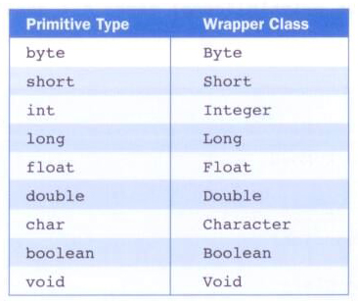
Wrapper Classes
The java.lang package contains wrapper classes that correspond to each primitive type:

Slide 54
Wrapper Classes
The following declaration creates an Integer object:
Integer age = new Integer(40);
An object of a wrapper class can be used in any situation where a primitive value will not suffice
For example, some objects serve as collections of other objects
Primitive values could not be stored in such collections, but wrapper objects could be

Slide 55
Wrapper Classes
Wrapper classes also contain static methods that help manage the associated type
For example, the Integer class contains a method to convert an integer stored in a String to an int value:
num = Integer.parseInt(str);
The wrapper classes often contain useful constants as well
For example, the Integer class contains MIN_VALUE and MAX_VALUE which hold the smallest and largest int values

Slide 56
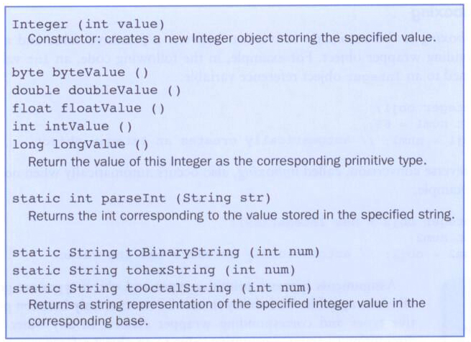
Wrapper Classes
Some methods of the Integer class:

Slide 57
Autoboxing
Autoboxing is the automatic conversion of a primitive value to a corresponding wrapper object
Integer obj;
int num = 42;
obj = num;
The assignment creates the appropriate Integer object
The reverse conversion (called unboxing) also occurs automatically as needed

